Slide 1

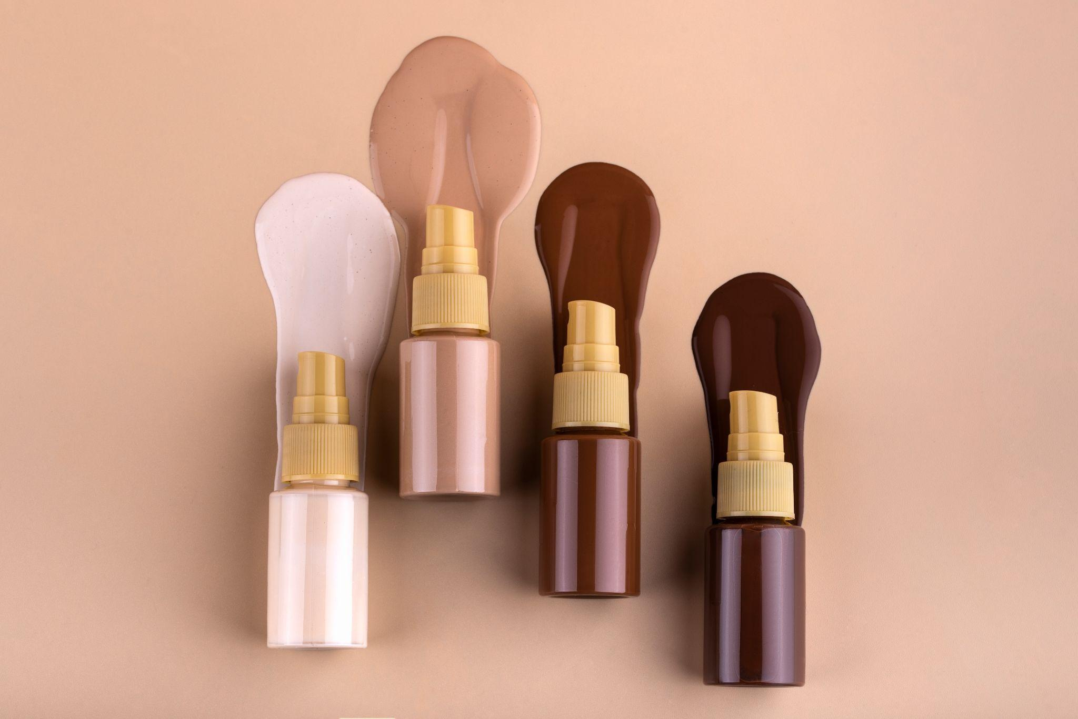
Consumer Bliss
Brand Success
Dawn Gleeson-Roy

Slide 2

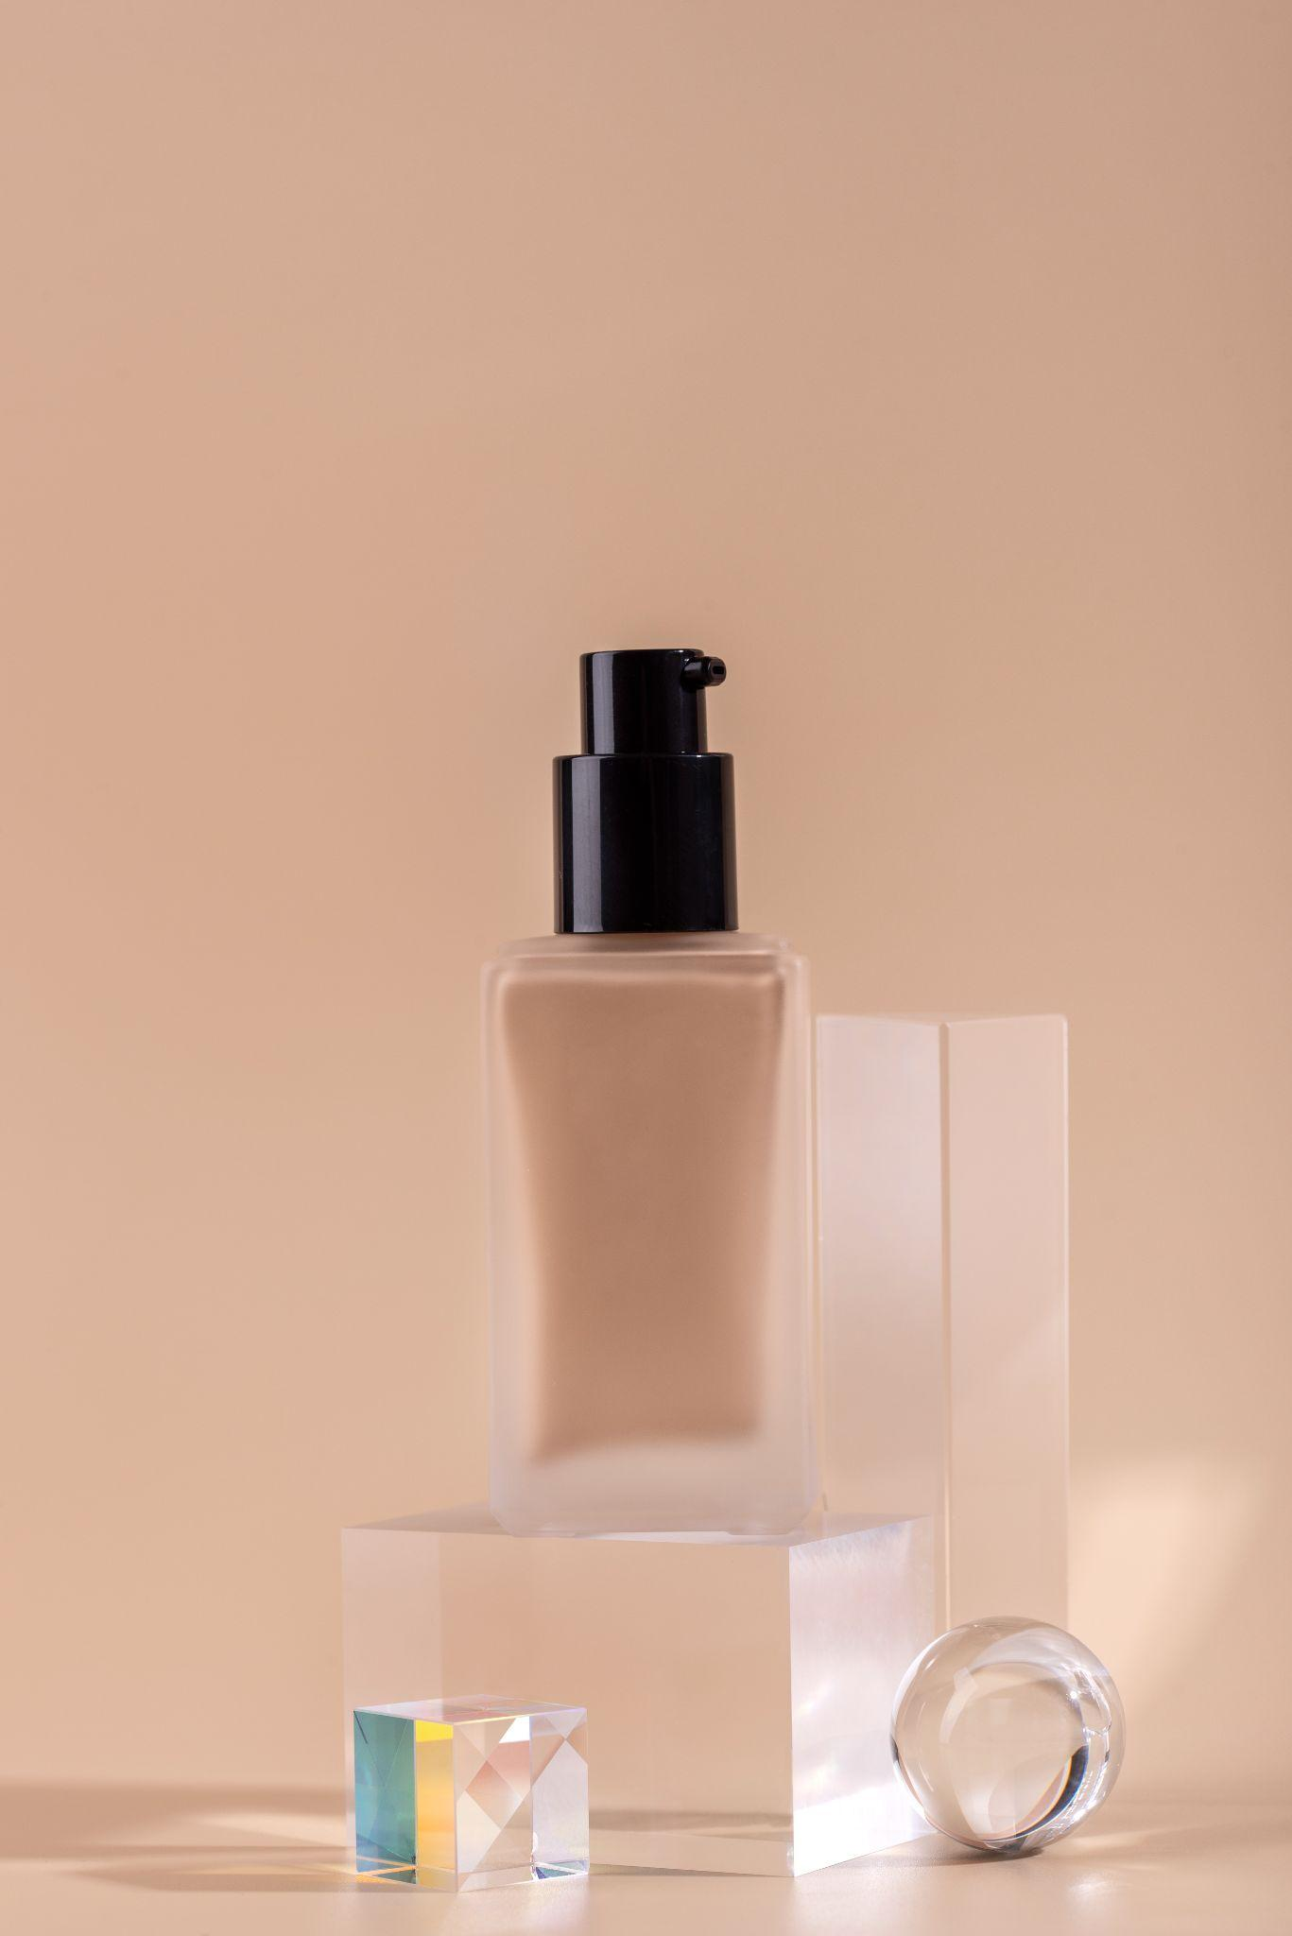
01
Goals

Slide 3
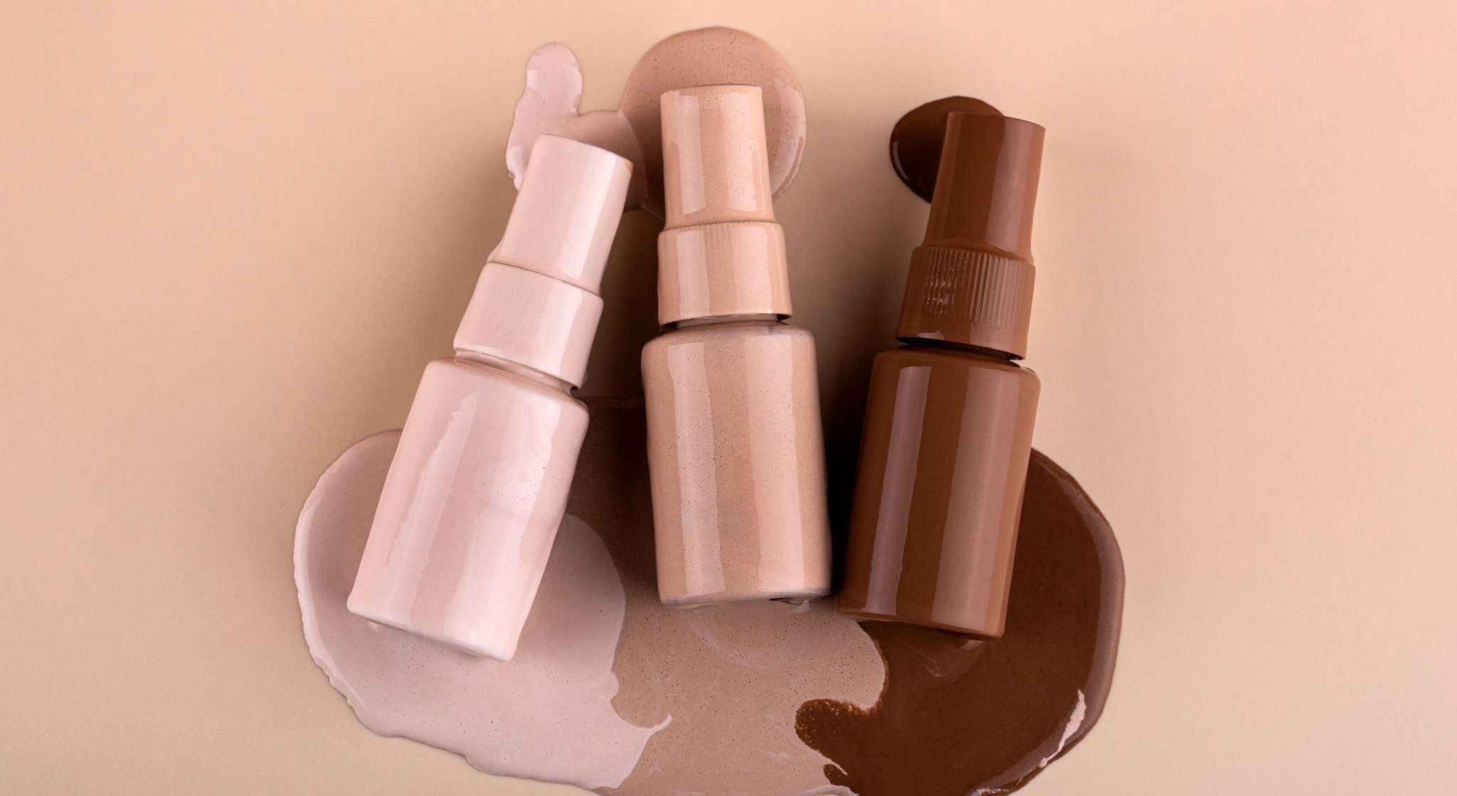
Based on a consumers reviews and ratings can we predict what products they may or may not enjoy?

Slide 4
02
Process

Slide 5
Timeline of Project Process
Retrieve & Clean Data, Identify data types
Perform EDA on Dataset
Model
Building
Personalize
The Data
Identify Next Steps

Slide 6
03
Results

Slide 7
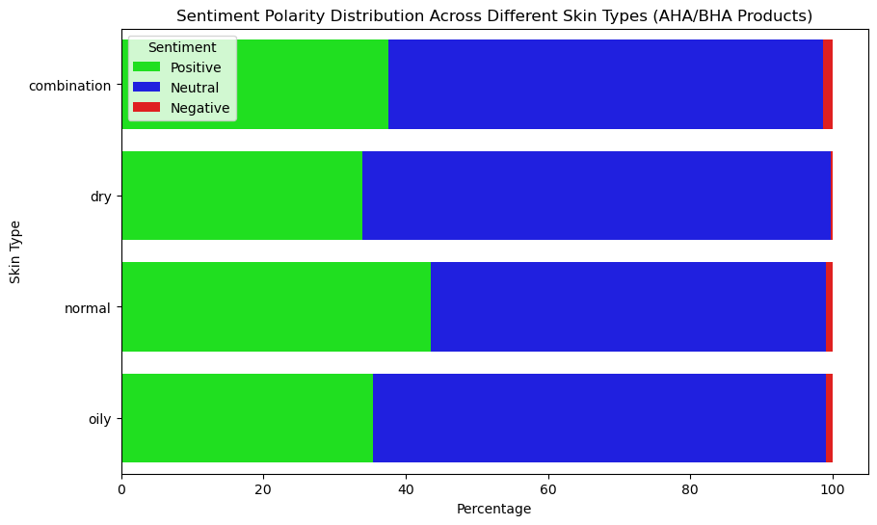
Chi-Square:
Correlation found
Sentiment Analysis:
Neutral dominance
Skin Type:
Normal positivity

Slide 8
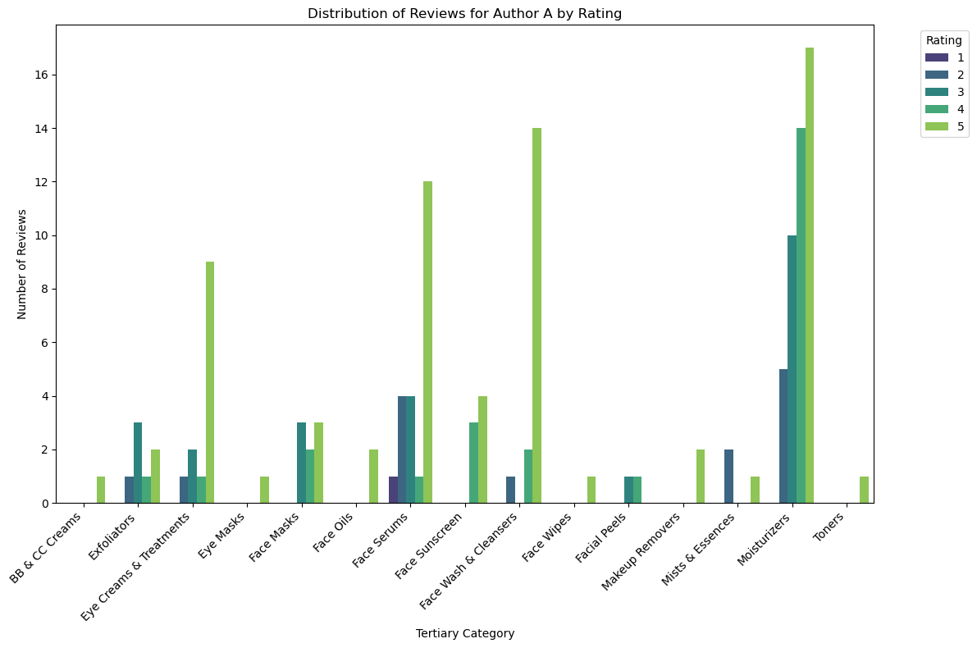
Author A Analysis:
Top Reviewer
155 Reviews
Review Distribution:
Skin care focus.
Top Categories:
Moisturizers, serums, cleansers.
Rating Consistency:
Consistent 5 stars.

Slide 9
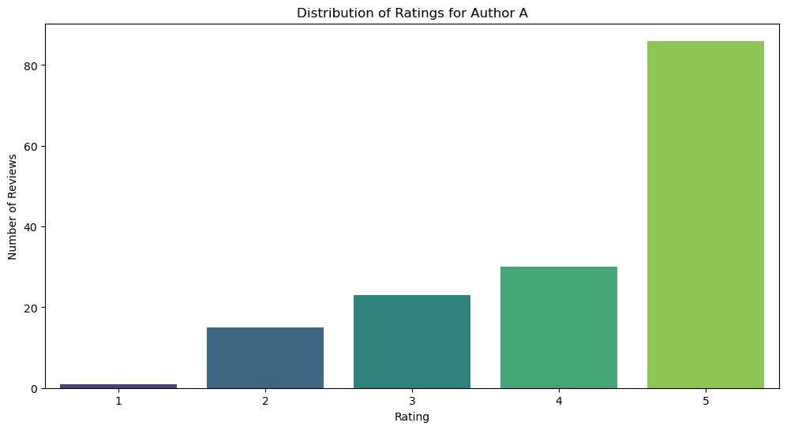
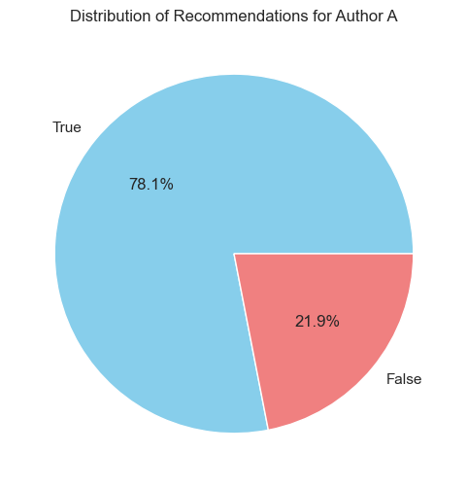
Rating Distribution:
Majority: 5 stars.
Few: 1 star.
Recommendation Rate:
78.1% recommendation.
Inclusive of 3-star and one 2-star review.

Slide 10
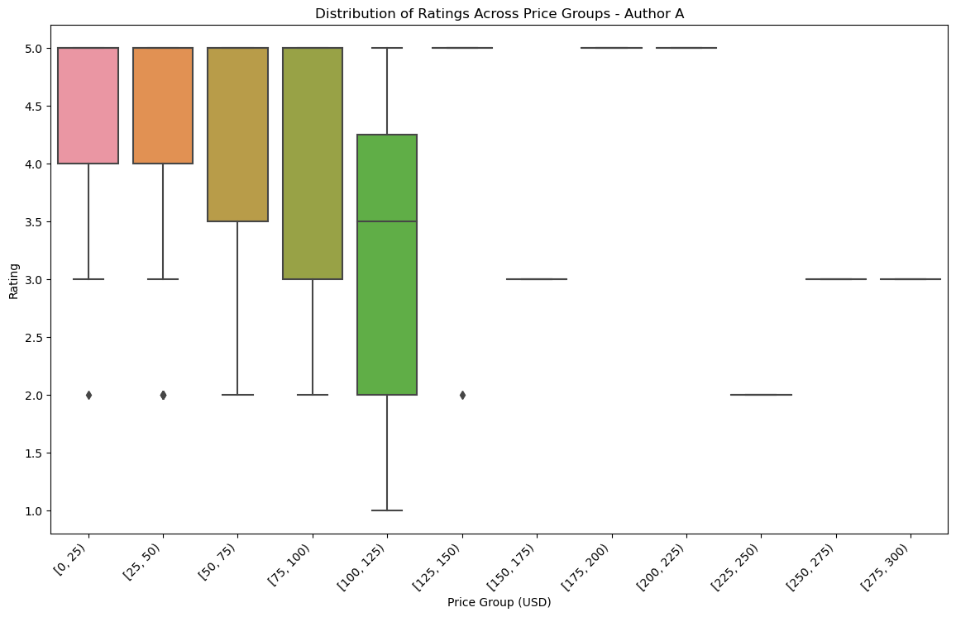
Price vs. Ratings:
Majority: 0-125$ range.
Price increase ➔ more 3-star or less reviews.
Expectation Pattern:
Higher price ➔ Higher expectations.
Vice versa.
Outliers Insight:
Lower price ➔ Strong dissatisfaction for negative review.

Slide 11
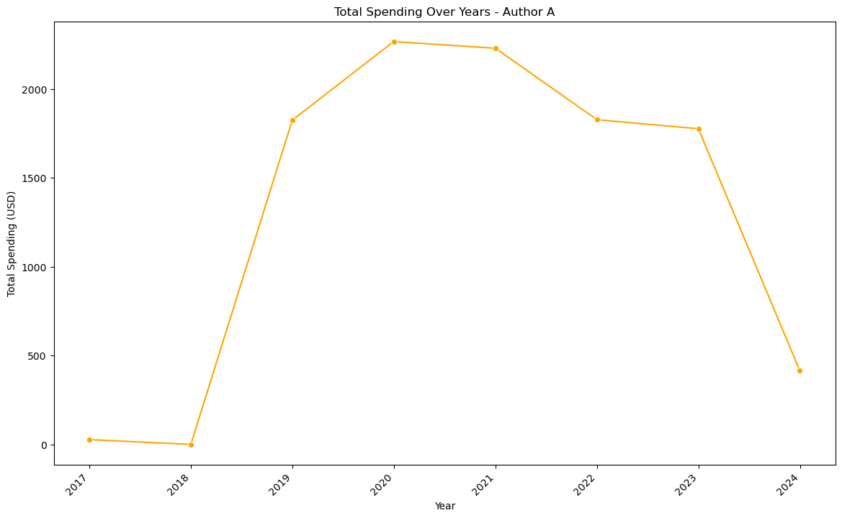
2018-2019 Surge:
Significant increase.
Peaked in 2019.
2020-2022 Decline:
Gradual decrease.
2023 Plunge:
Sharp decline.
Potential missing data (last review in March).
Review Insight:
2023: Predominantly negative.
Caution: Correlation with spending drop, considering potential missing data.

Slide 12
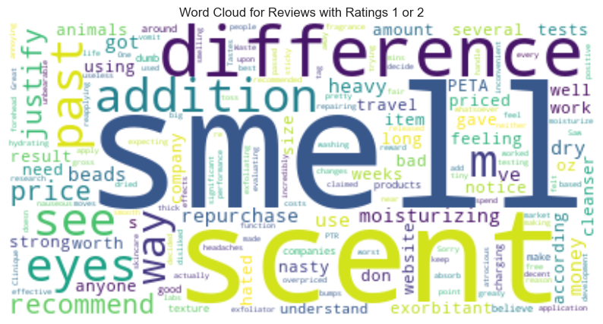
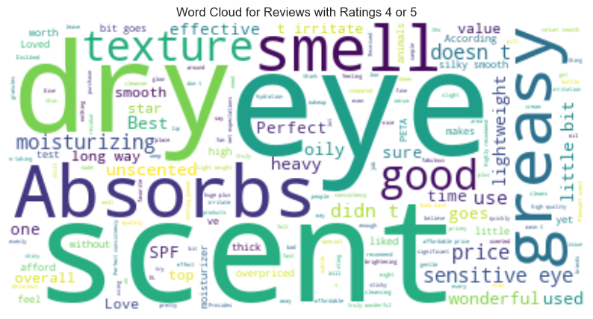
Essential Oils
Complex and Intense
Extract, Juice
Neutral, Clean, Fresh

Slide 13
04
Challenges

Slide 14
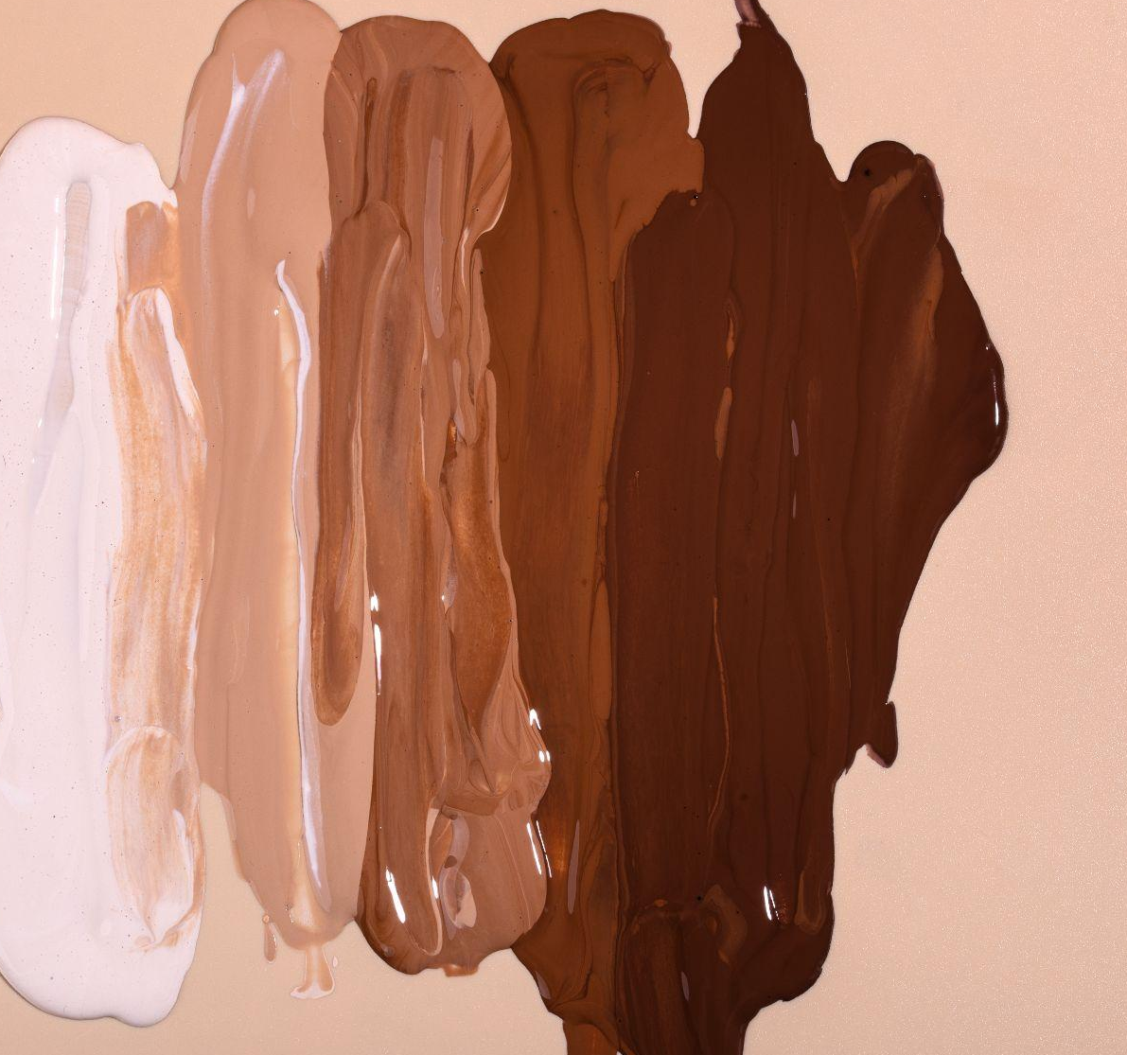
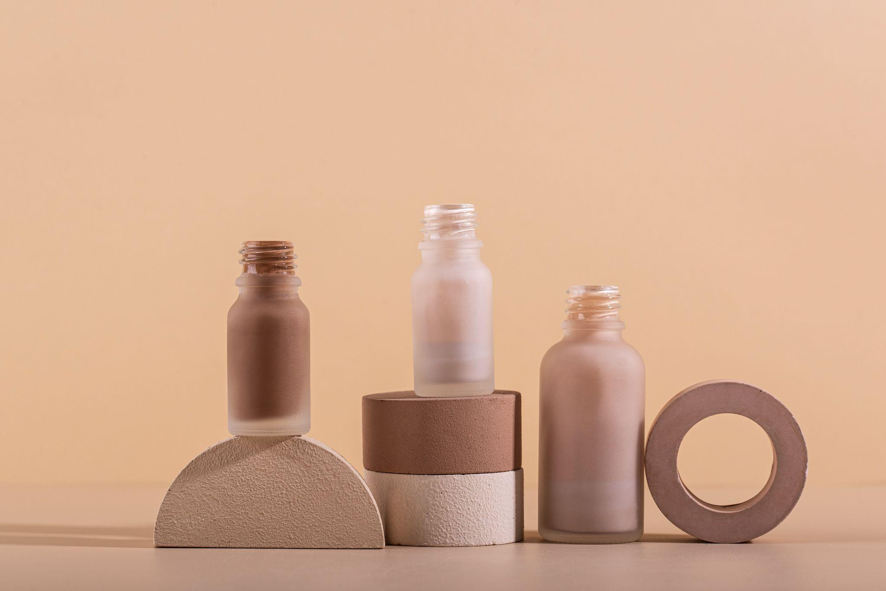
Limited Consumer Knowledge
Data Quality
New Library
Free or purchased
Repurchase Amount
Age and Skin Concerns
Limited Reviews
Limited Products
Wordbubble
Sentiment Analysis

Slide 15
05
Future Goals

Slide 16
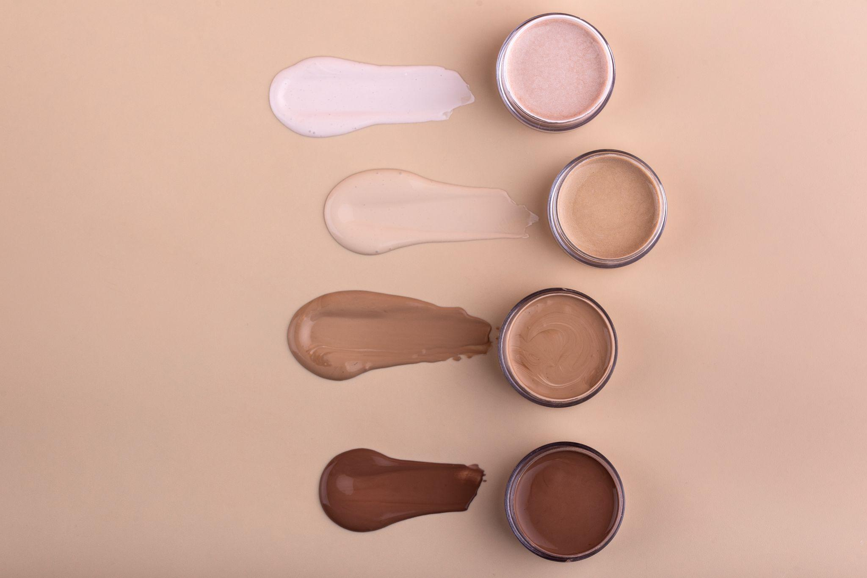
Future Goals
01
02
03
Consumer Research
Association Rule Mining
Temporal Analysis

Slide 17
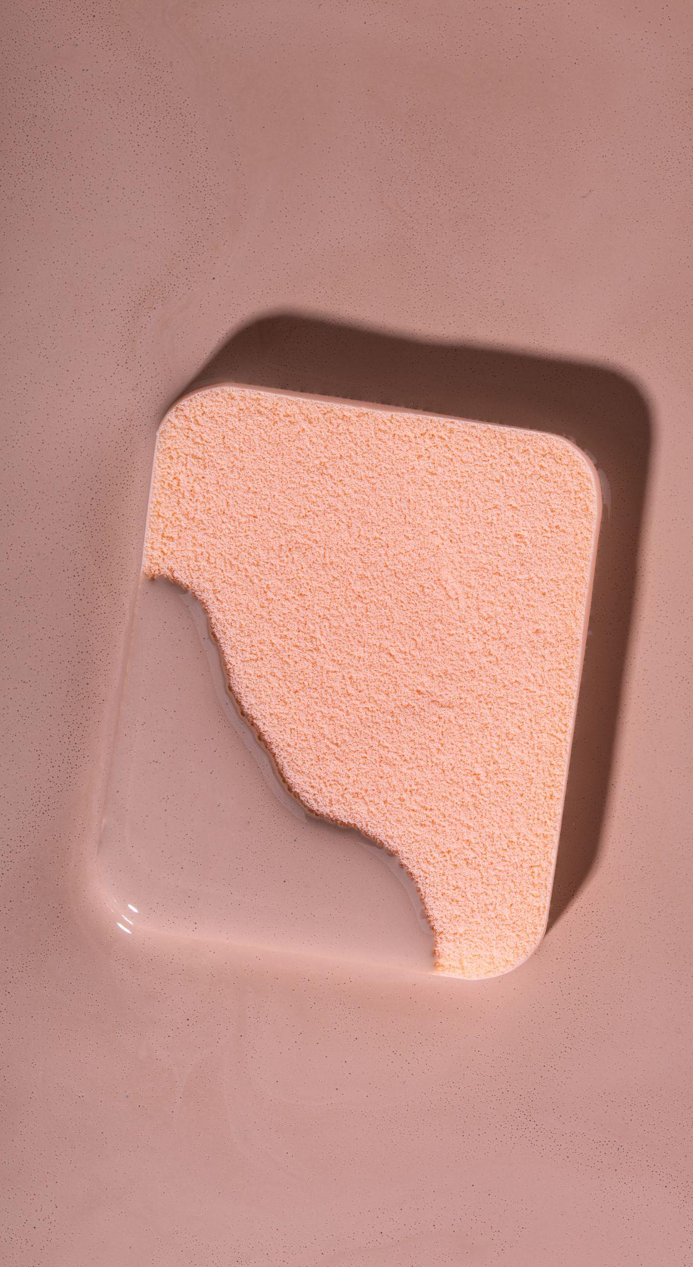
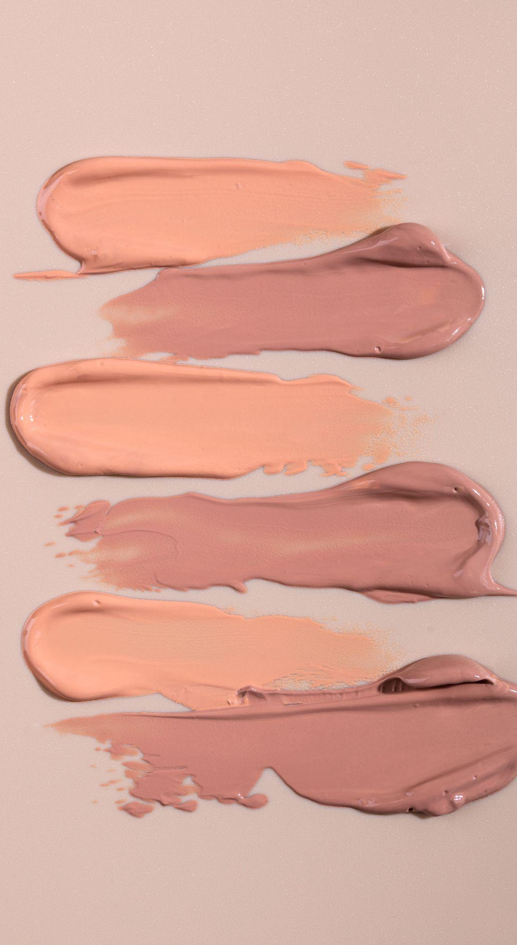
Thanks!
Please keep this slide for attribution

